Slide 1
Entering Grade 12 Course Selection 2019-20
Grade 11
Homeroom Teacher Presentation

Slide 2
Graduation Requirements

Slide 3
Graduation Requirements
All Grade 10 courses must be passed
ELPA must be passed
Compulsory Courses
English 11 (full-year, 2 credits)
Math 11
Science
History 11
Fine Arts & Life Development course
English 12
Total: 7 credits

Slide 4
Graduation Requirements
Must earn 17 out of 20 credits
Remaining 10 credits are elective
5 credits must be Grade 12 courses (incl. Eng 12)
Only 2 of the 17 can be local options
You are responsible for insuring that you meet graduation requirements!

Slide 5
Choosing Courses
Choose compulsory courses first; make sure you have all grade 10 and all 7 grade 11 compulsory requirements met
Note if prerequisites required-See Course Guide
You may take both Grade 11 and Grade 12 courses to meet your needs
Consider future learning/career goals
Work, community college, university, private training school, apprenticeship, military
Discuss with parents, teachers, counsellors

Slide 6
Remember
Graduation Requirements and
Post-Secondary Admission Requirements
are not the same
It’s up to you to do some research and ensure
you have the right courses for admission.
What is accepted for admission at one school is not necessarily accepted at another

Slide 7
Courses Requiring Applications
Some courses require an application
All applications available at Guidance
All applications are due March 29th at Guidance
Do not select courses requiring an application as an alternate

Slide 8
The Course Selection Guide
Read It!
Decisions you make now impact the final year of your secondary schooling☺

Slide 9
Your course guide. . .
Read course descriptions carefully
Course Name, Grade, Level
Prerequisites, Co-requisites, recommended prerequisites (very important)
At end of description
course fees
application required-all due March 29th

Slide 10
11N
Complete the top section to verify meeting Grade 10 requirements
Complete the Grade 11 section to verify meeting compulsory requirements
Complete the Grade 12 section ensuring that you meet graduation requirements and applicable post-secondary admission requirements

Slide 11
Completing Your Planning Form
Line #1: English 122 or 123
Line #2-10: Electives
Add Fine Arts/Life Role course if not taken in Gr. 11
Add two Alternate Courses at the bottom
Add a third alternate if you have selected FHS courses, Co-op, or Career Explorations
Carefully consider Alternate Courses.
They will be used if any of your chosen courses cannot be scheduled.

Slide 12
Choosing Courses
Choose courses carefully.
Courses chosen by students determine courses offered next year.
If you choose a course, you will be expected to remain in the course.
Once schedules have been created, course changes are not considered, with the exception of failures.

Slide 13
The Course Selection Process
All courses will be selected using an on-line request process through Power School
This will be done during Extended Homerooms March 18-21
You will need your user ID and password to gain access to the system
You will need a completed course selection form passed in to HR by March 14. Add HR# at top.
You will not be allowed to enter any course requests without a completed form

Slide 14
Once requests have been entered and submitted, they cannot be changed
You will receive a verification form listing the courses you have chosen
The form must be signed by your parent/guardian and returned
If there are any mistakes, mark them on the form and they will be made
There will be no changes made after this point except for failures

Slide 15
Failures
If you have failed a course, you must repeat it if it is a compulsory course
If not a compulsory course, you may repeat it if you wish to, but you my choose another elective
Remember, you need a minimum of 17 credits to graduate (7 Compulsory & 10 Electives)

Slide 16
Remember. . . Important
Be VERY, VERY careful to select the correct course and grade level when inputting course selections into Power School
FI Students please be especially careful to choose the FI course when entering selections.
Accuracy is important to avoid being scheduled into the wrong courses!

Slide 17
Remember…
You can
Talk to me!
Talk to your parents!
Talk to your teachers!
Talk to your counsellor!

Slide 18
The following slides should be shown now and again during the Extended Homerooms March 18-21 to guide students through the process

Slide 19
Log-on Using Student ID & Password
In case of username /password unknowns: HR teacher must put a request in to tech teacher to reset it.
Login here: Student Course Selection Login Page
Step 1: Choose Compulsory English 12 course
Step 2: Choose Elective courses
Step 3: Choose 3 Alternate Electives

Slide 20
Special Note-Music Electives
If choosing Music 112 as an elective, you may choose only 1 of the 4 strands
Guitar FEMUD1120 Music 112
Instrumental FEMUD1110 Music 111
Keyboard FEMUD1130 Music 113
Choral FEMUI0092 Music Art (90hr) 9
When choosing, be sure to select the above course names for the strand you want

Slide 21
Special Note-Application Courses
Courses requiring an application are to be selected when inputting courses
Applications are due March 29
If you do not fill out an application and input the course as a selection, you will not be considered for acceptance and will be removed

Slide 22
Special Note-Alternate Courses
You must choose 3 Alternate Courses
Choose these carefully
They will be used if all the courses selected cannot be scheduled due to conflicts

Slide 23
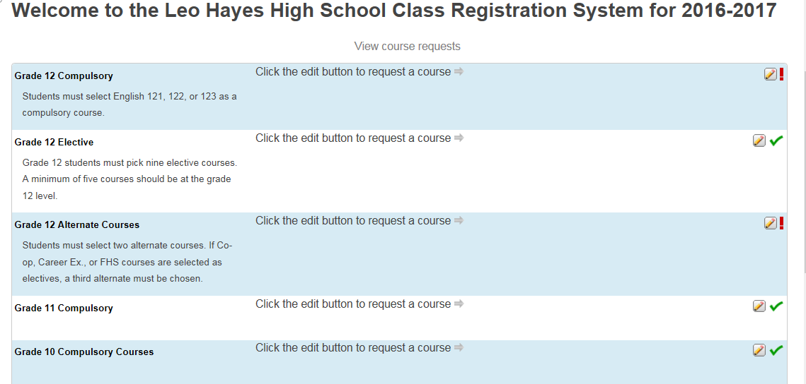
2019-2020

Slide 24
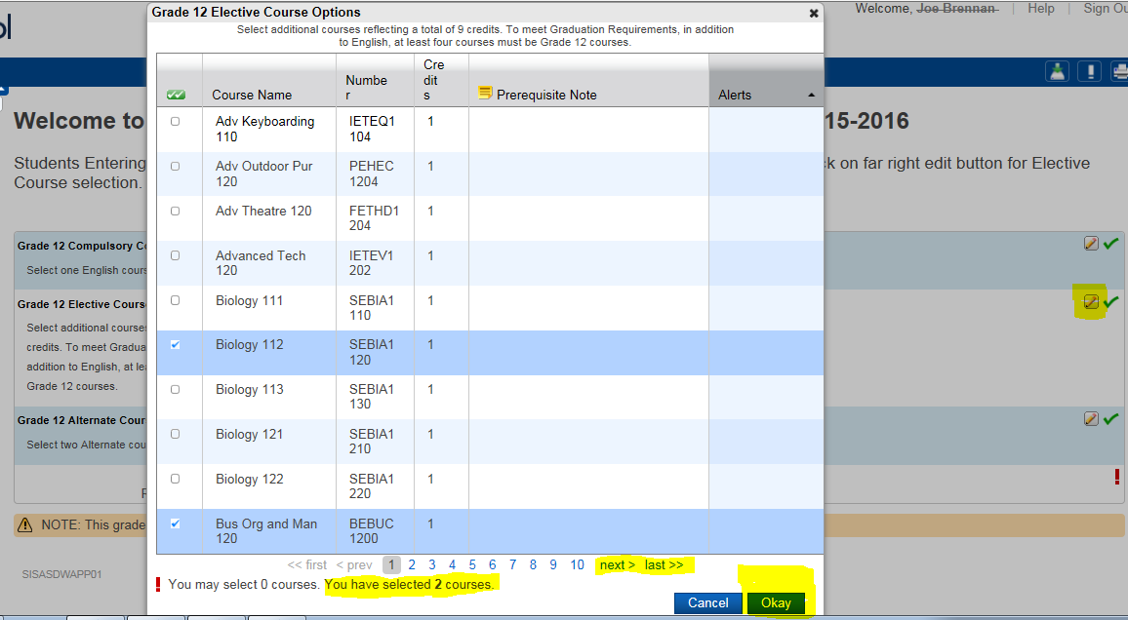

Slide 25
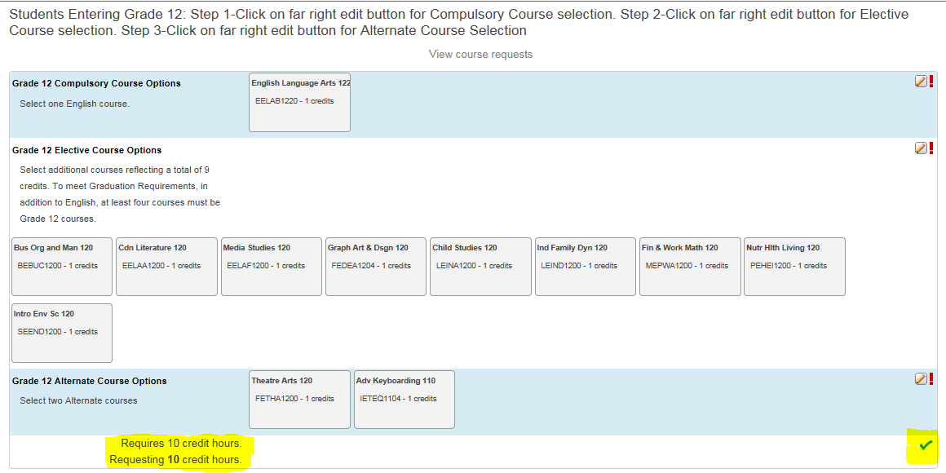

Slide 26
Before you hit submit. . .
Have your homeroom teacher verify that the courses on your screen match the courses on your planning form and hit submit
Give your planning form back to your homeroom teacher to file
Log Off so next student can Log On

